Slide 1
Making Leeds the Best City to Grow Old in
www.opforum.org.uk | info@opforum.org.uk | 0113 244 1697 | @LeedsOPF
Leeds Older People’s Forum is a registered charity (#1191030) and a registered company in England and Wales (#CE023712).

Slide 2
Older People & Food Insecurity 2024
Report commissioned by Public Health, Leeds City Council
August 2024
www.opforum.org.uk | info@opforum.org.uk | 0113 244 1697 | @LeedsOPF
Leeds Older People’s Forum is a registered charity (#1191030) and a registered company in England and Wales (#CE023712).

Slide 3
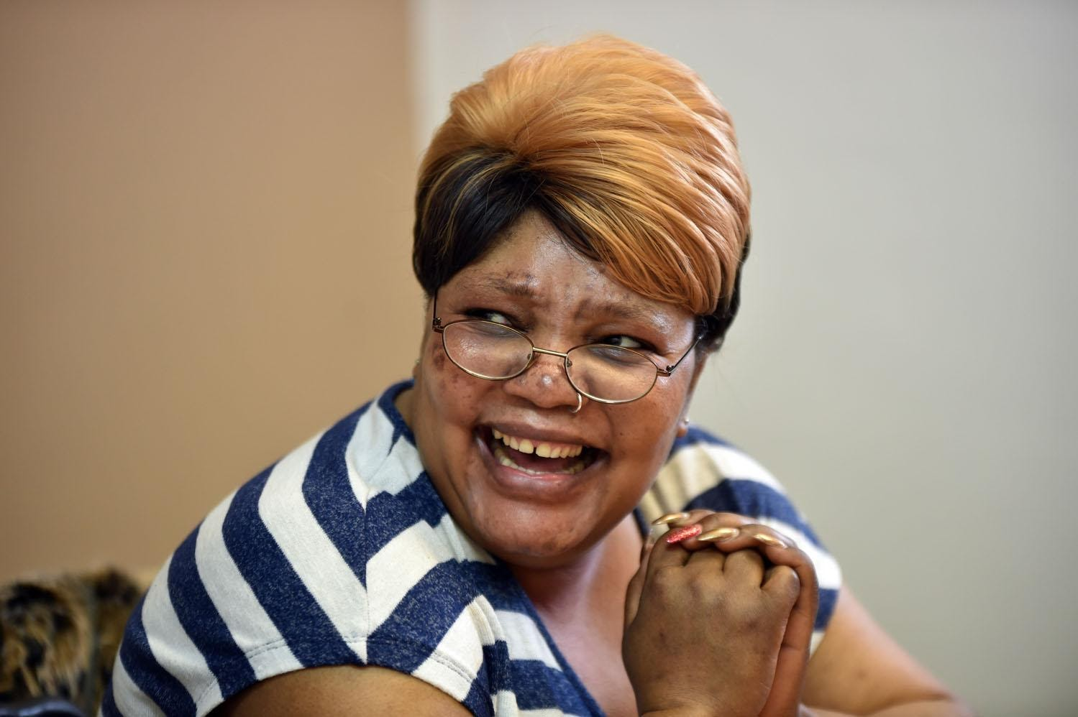
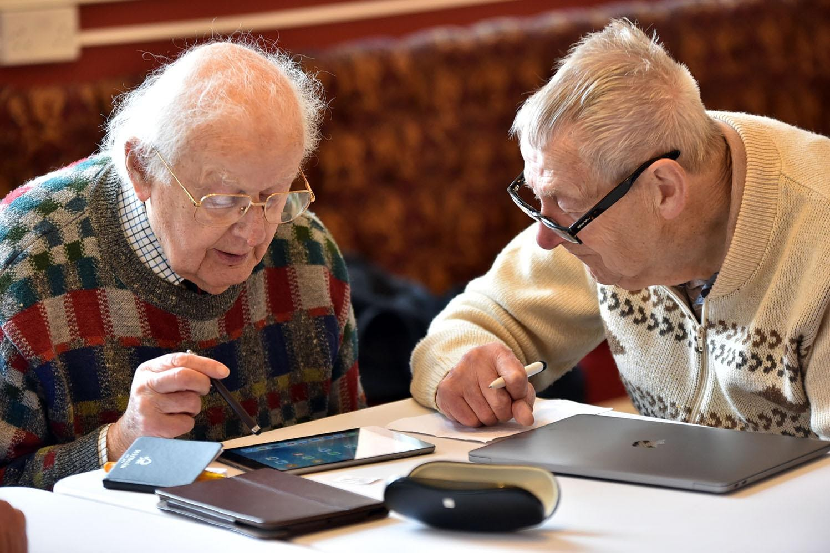
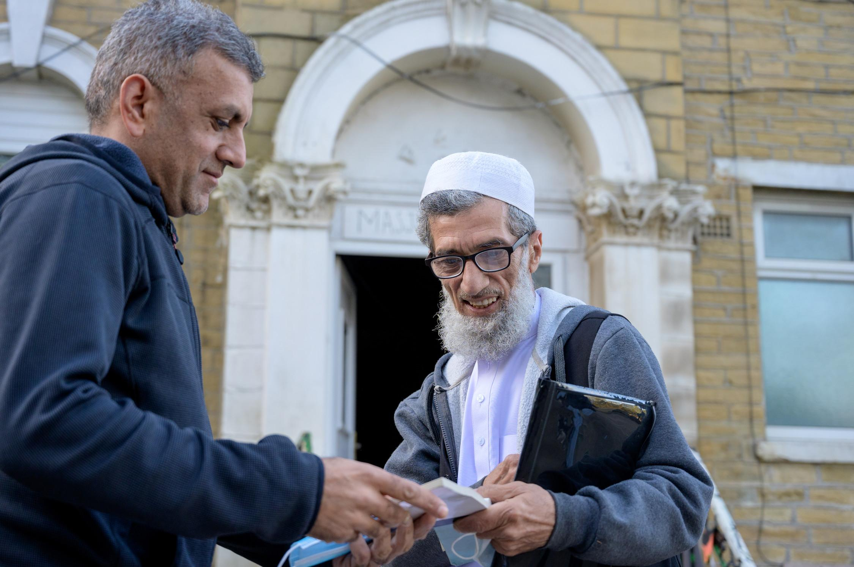
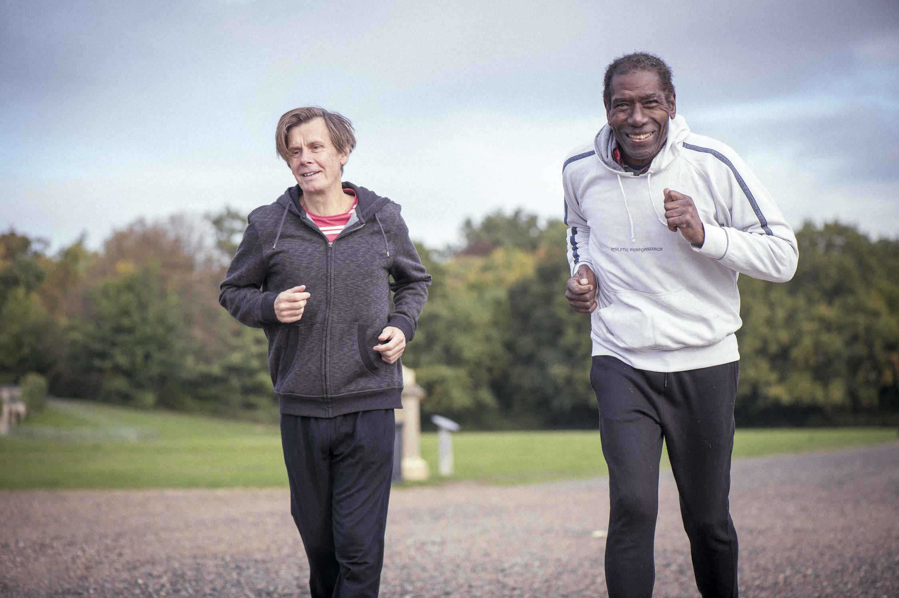
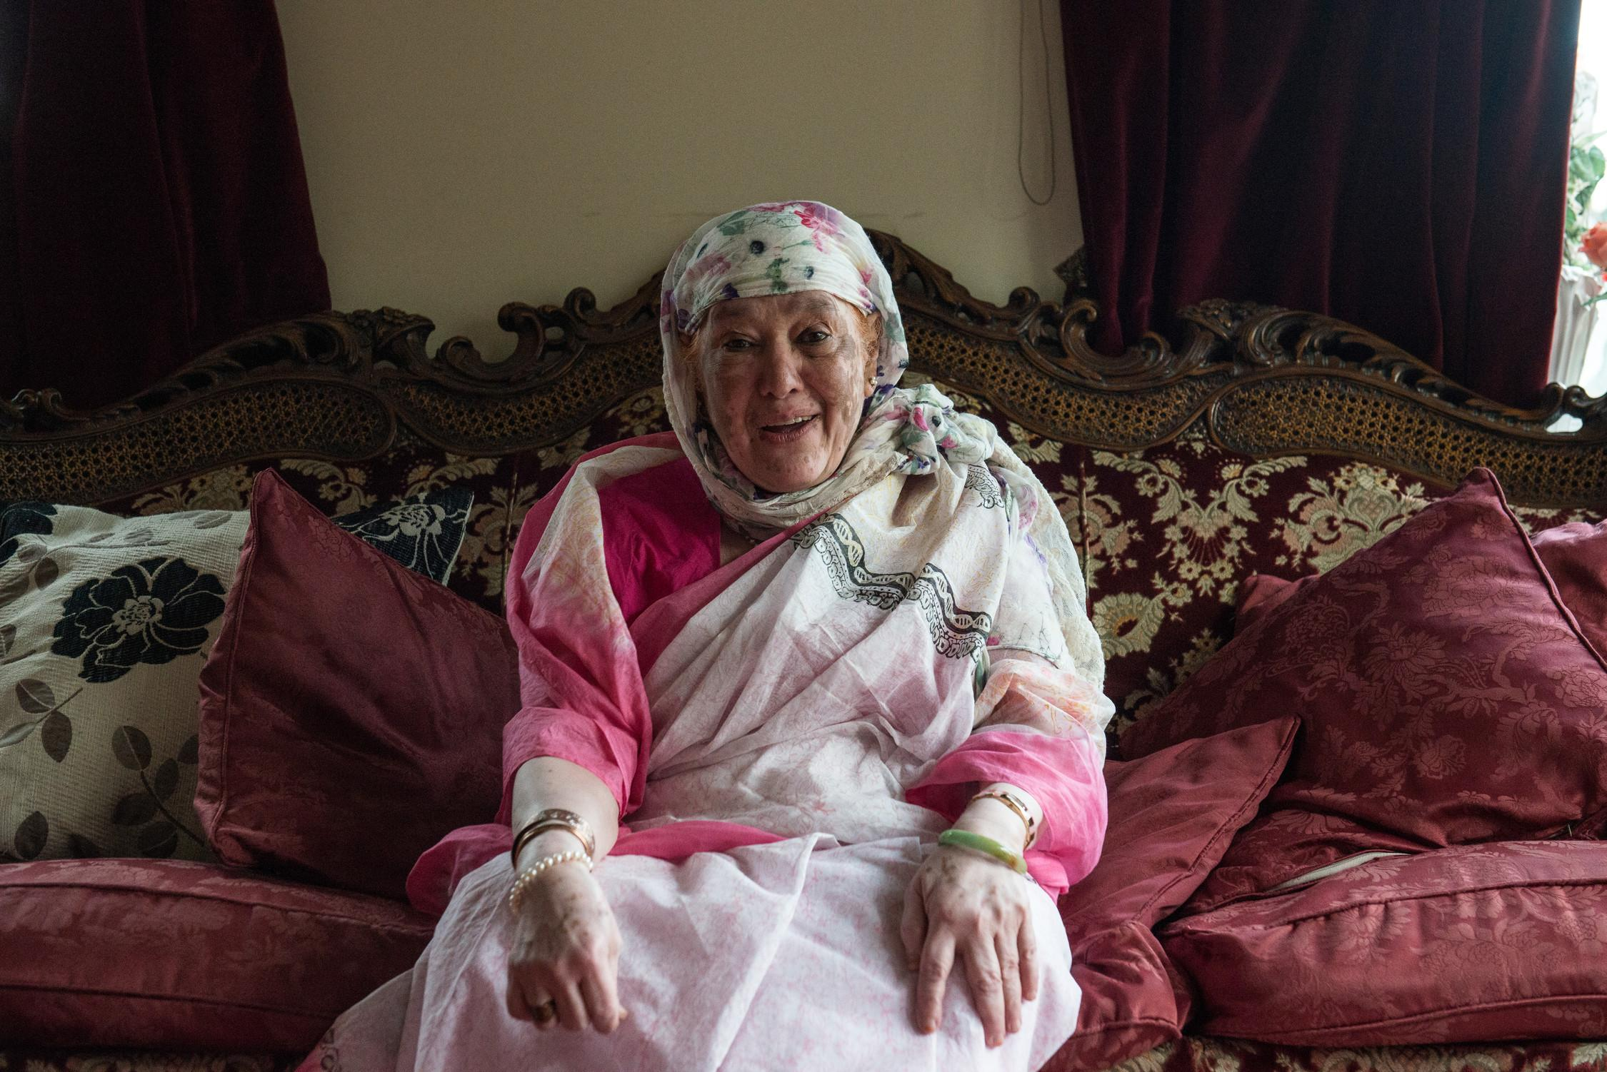
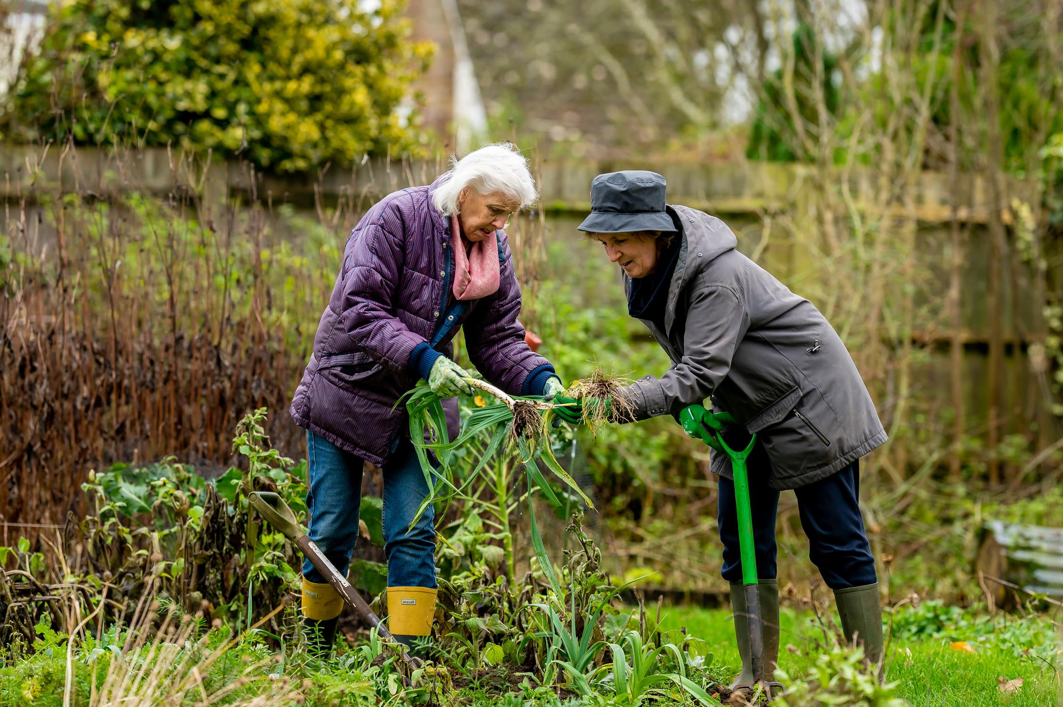
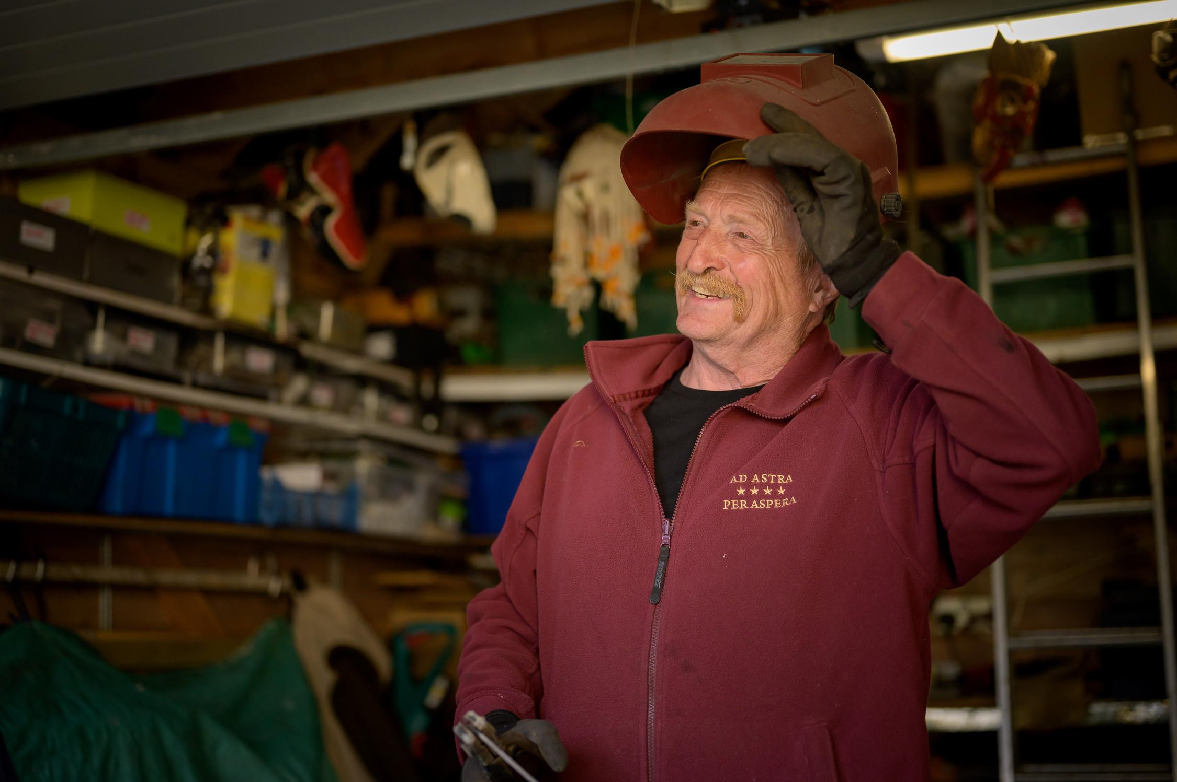
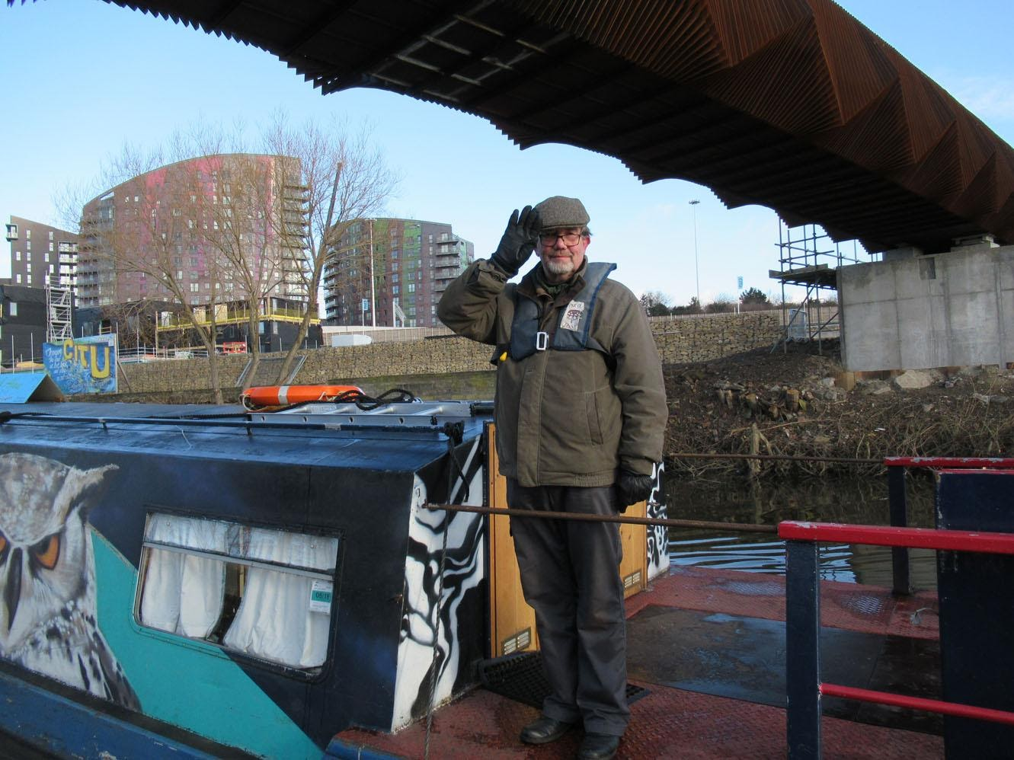
Context for this report & recommendations
This report should be used in conjunction with:
Director of Public Health’s Annual Report: Ageing Well: Our Lives in Leeds
Leeds Health and Wellbeing Strategy
Joint Strategic Assessment
Leeds Food Strategy
Age Friendly Leeds Strategy and Action Plan
Leeds Best City Ambition’s three pillars

Slide 4
Why Older People’s Food Insecurity Matters
It costs our health & social care services a lot of money
Estimate “the total annual cost to our country’s health and social care services of malnutrition amongst older people to be £11.9 billion. We estimate also that this sum will increase to £13 billion in 2020, and again to £15.7 billion by 2030.” Feeding Britain 2018
It’s going to affect a growing % of our population
By 2041 in Leeds: 50-59 age group will reduce; 60-69 little change; 70+ substantial growth; 80+ 50% increase
Rising inequalities will make its impact even worse
Women in the most affluent areas of Leeds live 14 years longer than those in the least affluent areas; men in the most affluent areas of Leeds live 12 years longer than those in the least affluent areas; the impact of food insecurity exacerbating multi-morbidities and the costly support to manage long term conditions

Slide 5
Food Insecurity: more than “just” food poverty
Changes in age-related capabilities & circumstances
Can affect a person’s food shopping; preparation & cooking abilities; appetite, eating habits and feeding ability; as well as their attitude and capabilities
Sudden or new changes
e.g. newly retired, recently bereaved, recently discharged from hospital, no longer able to drive
Cumulative and/or progressive changes
e.g. dementia, arthritis, multiple morbidities, becoming increasingly frail (changes to balance, strength, fine motor control), teeth becoming weaker/looser, worsening isolation

Slide 6
Factors affecting older people’s food insecurity
Older people + food insecurity
+ poverty
Changes in age related capabilities & circumstances
Social
Physical
Deprivation & income
Housing
Ethnicity
Disability
Gender
Health
Sexuality
Single/couple/family
sudden
Mental
Attitudinal
progressive
cumulative
Geography
Community

Slide 7
Factors affecting older people’s food insecurity
Housing
Asset rich, cash poor homeowners; impact of rising rent costs on renters
Access to funding & benefits
Attendance & Carers Allowances
Pension Credit – 2 out of 5 eligible people in Leeds don’t claim: estimated £30 million unclaimed pension credit in Leeds
Housing benefits & utilities support/payments
Transport costs (access bus, community transport, blue badge)
TV, digital & phone deals
Digital exclusion
“Digital First” approach to many associated services and support – common barrier for older people

Slide 8
Factors affecting older people’s food insecurity
Transport
Access to public transport; the value of community transport for more personalised support; Blue Badges for enabling family/unpaid carers – its role tackling isolation for physical/mental good health
Ethnicity
Ready access to affordable culturally appropriate foods
Cultural stigma and language barriers coupled with difficulty accessing culturally competent food aid and associated support
People with a disability
2021-22 period: 11% of households with a disabled adult reported experiencing food insecurity, compared to 3% of households without a disabled adult (Family Resources Survey, DWP)
Additional costs, e.g. increased need for heating, medical equipment, specific dietary requirements, etc.

Slide 9
Carers for older people are often older people themselves
Over 10,000 unpaid carers aged 65-79
Nearly 3,000 unpaid carers aged 80+
Carers Leeds top three concerns:
“My own health & wellbeing needs”
“The changing needs of the person I care for”
“Money and the Cost of Living”
Evidence of carers going without essentials, such as skipping meals, and an increase in carers reporting using foodbanks

Slide 10
Taking an asset-based approach
The importance of connecting statutory, private and Third sector services and support to overcome barriers to food security:
Leeds Neighbourhood Network, Leeds Community Anchor Network & Enhance programme – enable better wraparound support for older people where they live, which mitigate food insecurity
Better work with supermarkets, cultural food shops, cafes and bars: e.g. social spaces, dementia friendly service, chatty tables
Enables Third Sector organisations to make the most of local partners - and people - to meet the specific needs of older people in the local community
Notes:
Report is split into two parts
First around the issues
Second part around the assets we have to work with to overcome some of those issues

Slide 11
Key findings (1 of 2)
Importance of wider determinants of health as part of food insecurity for older people
Understanding the importance of social support networks to older people for food security
Both in terms of facilitating food security, but also enabling prevention/early intervention relating to changes in age-related capabilities and changes in age-related circumstances
The importance of ensuring social support is not “designed out” in a bid to reduce service costs, without considering the health impact of isolation/loss of service provider touchpoints

Slide 12
Key findings (2 of 2)
Visibility and understanding of networks and organisations supporting older people and/or supporting food security
For commissioners & funders
For local service providers – statutory, private & Third Sector providers
For older people, their carers and families
Understand the needs and barriers that specifically relate to older people and food
For strategic decision-makers, programme managers and frontline staff
Take this into consideration for systems thinking, investment/disinvestment decisions, programme design and delivery, and collaboration/coordination across public, Third and private sectors

Slide 13
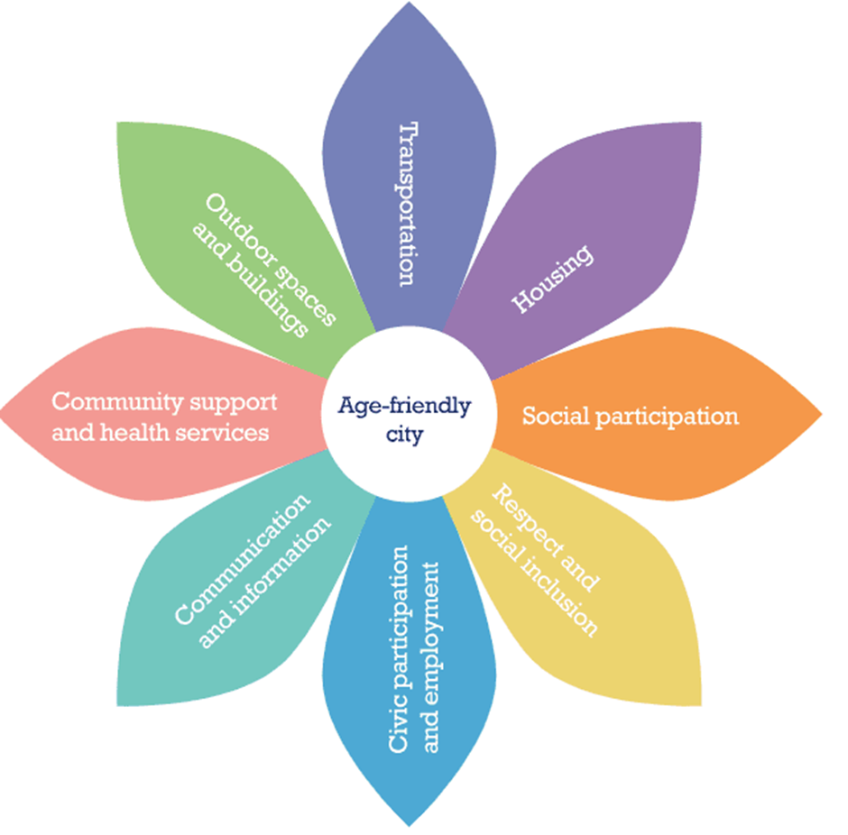
Older People & Food Insecurity – Key Factors
…You need to consider these barriers & issues …
… with collaboration across these system domains …
Deprivation & income | Housing
Ethnicity | Disability
Gender | Health
Sexuality | Single/couple/family
Changes in age related capabilities & circumstances: sudden
Changes in age related capabilities & circumstances: progressive
If you want to address this:…
Older People
Food Insecurity
Food Poverty
… and these factors …
Physical
Mental
Attitudinal
Social
Community

Slide 14
Recommendations: Strategic
Ensure strategic decision-makers, programme managers and frontline staff understand the needs and barriers that specifically relate to older people and food insecurity, and take these into consideration for systems thinking, investment/disinvestment decisions, programme design and delivery, and collaboration across public, Third and private sectors
Improve the infrastructure of support – including visibility, communication, and coordination between services.
Improve access to data
Supporting partner access to relevant data of individuals, with appropriate consent, to improve provision and coordination of Multi Disciplinary Team support around each older person
Sharing data to build a collective city-wide picture of older people’s food security needs and relevant assets, provision, etc.
Sharing data sets held by city partners and their networks to improve service planning, coordination and delivery
Improve data quality

Slide 15
Recommendations: Specific actions
Financial inclusion for ageing well - improve Pension Credit uptake as a gateway to other benefits such as Winter Fuel Payment
Transport – improve access to transport for food shopping
Digital inclusion - work with digital teams to upskill older people to use technology to order online shopping, and access other wraparound support that supports food security for older people
Age Friendly spaces / communities - encourage supermarkets, restaurants, local stores and cafes to consider older people in their offers
Undertake food desert mapping - to better understand food insecurity gaps
Funding - design funds to overcome barriers for food insecurity
Notes:
If we work on these together as #Team Leeds we will see more success in overcoming issues around food insecurity

Slide 16
Read the full report and more…
Link to LOPF website page: Older People and Food Insecurity
Link for more resources: Public Health Resource Centre
Contact us:
Get in touch and help us make Leeds the best city to grow old in!
Website: www.opforum.org.uk Twitter: @LeedsOPF
Email: info@opforum.org.uk Facebook: @leedsolderpeoplesforum
Phone: 0113 244 1697
www.opforum.org.uk

